Slide 1

Machine Learning Algorithms (Linear Regression)
Md. Abu Naser Mojumder

Slide 2
Well known Machine Learning Algorithms
Supervised Learning
Unsupervised Learning
Reinforcement Learning
Regression
Simple Linear Regression
Multiple Linear Regression
Polynomial Regression
Clustering
K-Means Clustering
Hierarchical Clustering
Upper Confidence Bound(UCB)
Thomson Sampling
Classification
Logistic Regression
k-Nearest Neighbors(k-NN)
Support Vector Machine(SVM)
Naïve Bayes
Decision Tree Classification
Random Forest Classification
Dimensionality Reduction
Principal Component Analysis(PCA)
Linear Discriminant Analysis (LDA)
Deep Learning Algorithm
Artificial Neural Network(ANN)
Convolutional Neural Network(CNN)

Slide 3
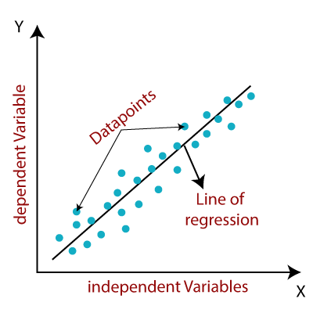
Regression
Regression models describe the relationship between variables by fitting a line to the observed data. Linear regression models use a straight line, while logistic and nonlinear regression models use a curved line. Regression allows you to estimate how a dependent variable changes as the independent variable(s) change.

Slide 4
Simple Linear Regression
Linear regression is a popular regression learning algorithm that learns a model which is a linear combination of features of the input example.
Simple linear regression is used to estimate the relationship between two quantitative variables. You can use simple linear regression when you want to know:
How strong the relationship is between two variables (e.g. the relationship between rainfall and soil erosion).
The value of the dependent variable at a certain value of the independent variable (e.g. the amount of soil erosion at a certain level of rainfall).
Two Main Objectives of Simple Regression:
Establish if there is a relationship between two variables.
Forecast new observations.

Slide 5

Simple Linear Regression
The equation of Simple Linear Regression:
bias term
co-efficient term
$$y=b_{0}+b_{1}∗x_{1}$$
dependent variable
independent variable
$b_{0}$ is a constant to fit the line properly. It is called y-intercept or bias.
$b_{1}$ is the slope of the relationship graph.

Slide 6
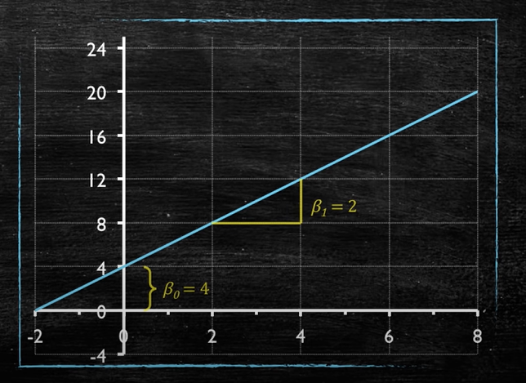




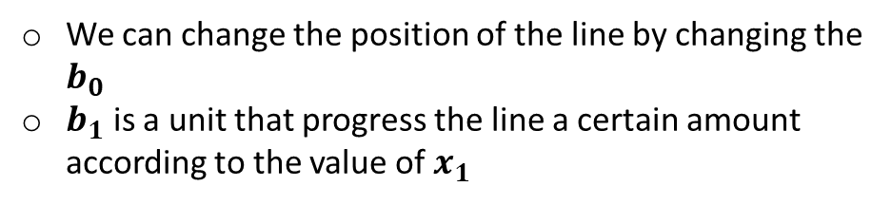
Simple Linear Regression
Example of Linear Equation:
$$y=b_{0}+b_{1}∗x_{1}$$
$b_{1}$ = 2
Equation in the figure:
$$y=4+2∗x_{1}$$
$b_{0}$ = 4
We can change the position of the line by changing the $b_{0}$
$b_{1}$ is a unit that progress the line a certain amount according to the value of $x_{1}$

Slide 7
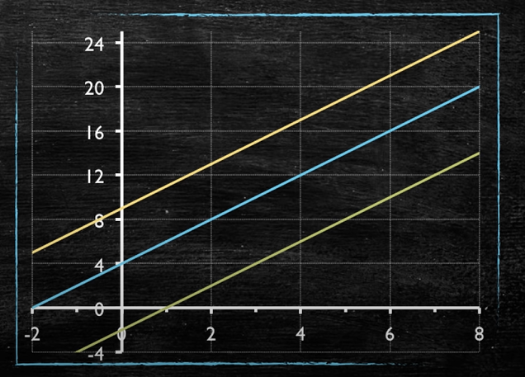



Simple Linear Regression
The changing effect of y-intercept:
$$y=9+2x$$
$$y=4+2x$$
$$y=−2+2x$$

Slide 8
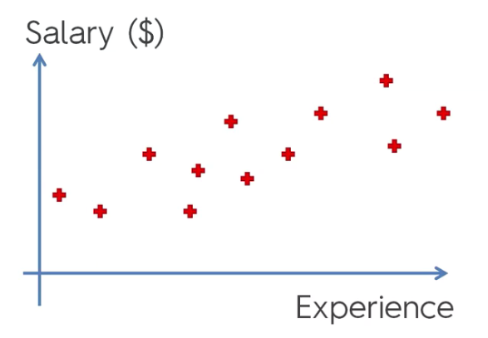

Simple Linear Regression
Example: Salary vs Experience
An employee’s Salary is in Y axis and Experience(Year) in X axis. We want to know people's salary depends on their experience.
The formula for regression is:
In our case it'll change to :
Initially it means just putting a line through your chart that best fits this data.
Y
$$y=b_{0}+b_{1}∗x_{1}$$
$$salary=b_{0}+b_{1}∗experiences$$
X

Slide 9
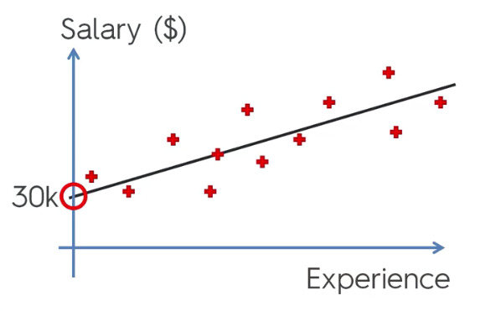
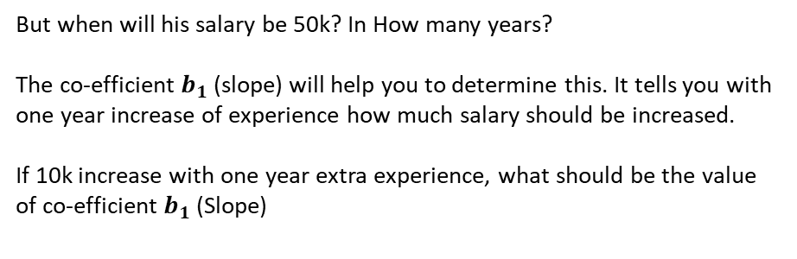
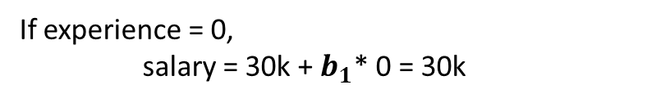
Simple Linear Regression
$$salary=b_{0}+b_{1}∗experiences$$
Meaning of the fitted line:
Let, $b_{0}$ = 30k
If experience = 0,
salary = 30k + $b_{1}$* 0 = 30k
That means, a person who is a fresher will get a salary 30k.
But when will his salary be 50k? In How many years?
The co-efficient $b_{1}$(slope) will help you to determine this. It tells you with one year increase of experience how much salary should be increased.
If 10k increase with one year extra experience, what should be the value of co-efficient $b_{1}$ (Slope)
Any Guess?

Slide 10
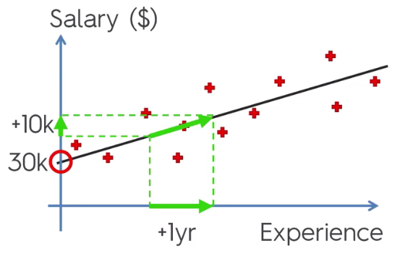
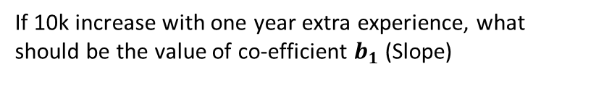
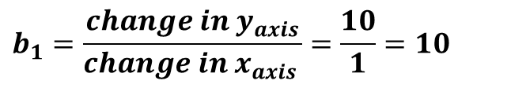
Simple Linear Regression
If 10k increase with one year extra experience, what should be the value of co-efficient $b_{1}$ (Slope)
$$b_{1}=\frac{change in y_{axis}}{chang{e in x}_{axis }}=\frac{10}{1}=10$$
If the Slope is less, the salary increase will be less.
If the Slope is greater, the salary increase will be greater.

Slide 11
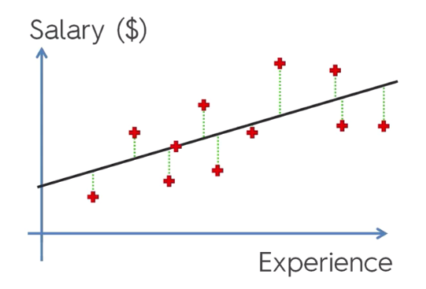
Simple Linear Regression
How to find the best fitted line?
Red dots are the actual observation
Lets, draw some vertical line from these dots to our regression model.
Take an example,
at a 10 years experience what is the actual observation and what is the predicted?
From this difference(error) we can see the model’s performance.
Actually, get the minimum errors is our goal in a regression model!

Slide 12
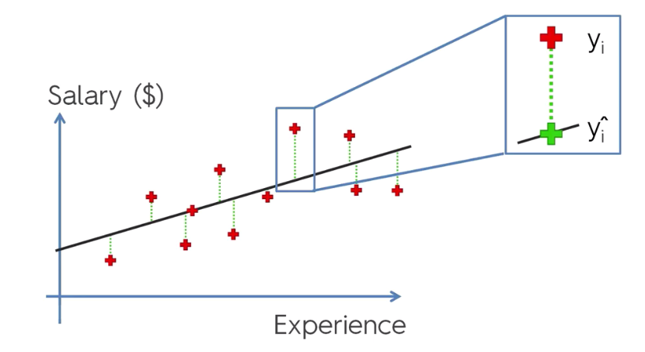
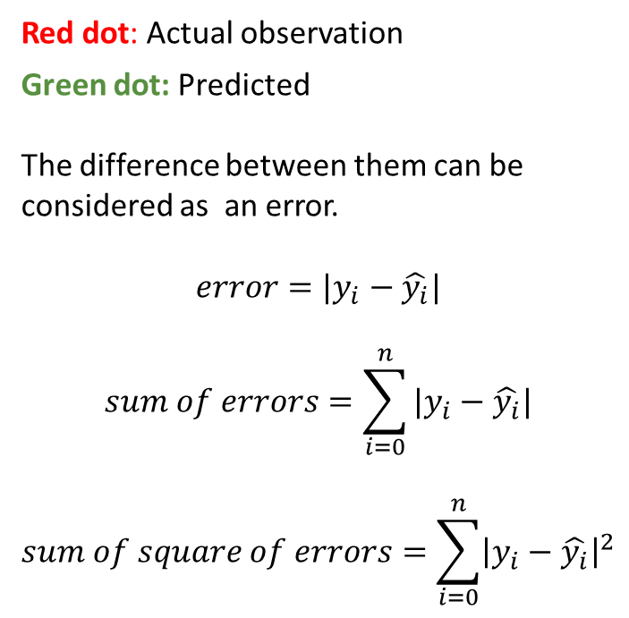
Simple Linear Regression
Red dot: Actual observation
Green dot: Predicted
The difference between them can be
considered as an error.
$$error=|y_{i}−\hat{y_{i}}|$$
$$sum of errors=\sum_{i=0}^{n}{|y_{i}−\hat{y_{i}}|}$$
$$sum of square of errors=\sum_{i=0}^{n}{{\left|y_{i}−\hat{y_{i}}\right|}^{2}}$$
+
+
+
+
+
+
+
+
+
A best fit is that, where sum of square of errors is the lowest.

Slide 13
Simple Linear Regression
Example: Consider the following data where x is the independent variable and y is the dependent variable.
x | y
1.00 | 1.50
2.00 | 2.00
3.00 | 2.50
4.00 | 3.50
5.00 | 5.50
6.00 | 5.00
7.00 | 8.00
Find the values of Coefficient and the y-intercept.
Draw a regression line.

Slide 14

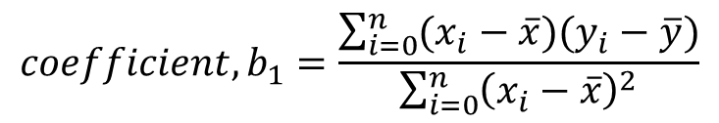
Simple Linear Regression
Finding Coefficient and y-intercept
$$coefficient, b_{1}=\frac{\sum_{i=0}^{n}{(x_{i}−\overline{x})(y_{i}−\overline{y})}}{\sum_{i=0}^{n}{{\left(x_{i}−\overline{x}\right)}^{2}}}$$
$y_{intercept} , b_{0}=\overline{y}−b_{1}\overline{x}$

